Slide 1
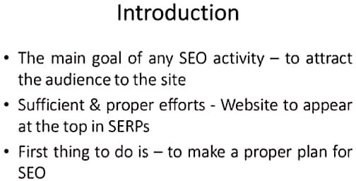

Slide 2
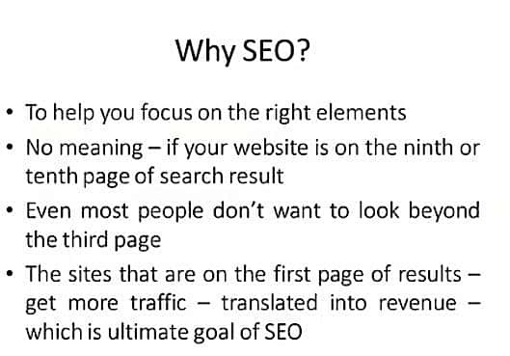

Slide 3
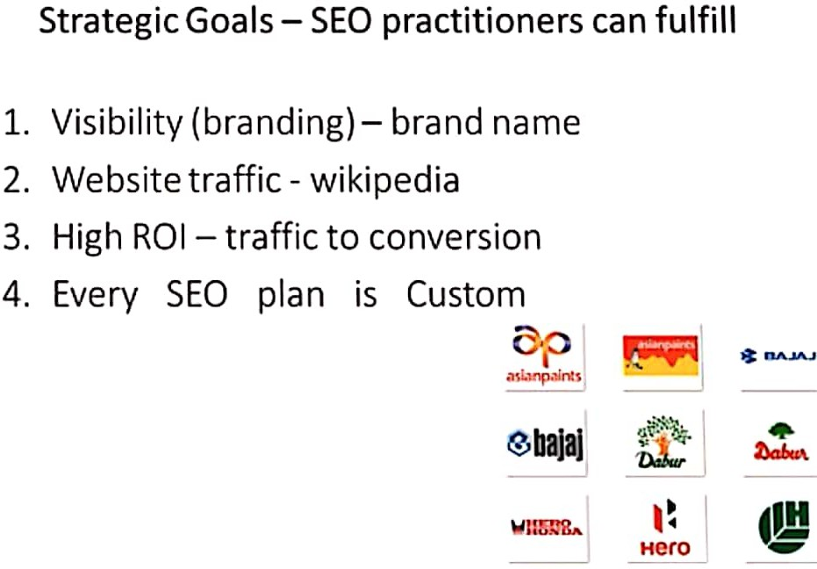

Slide 4
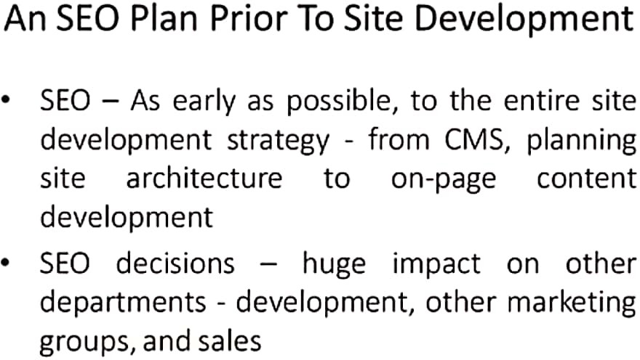

Slide 5
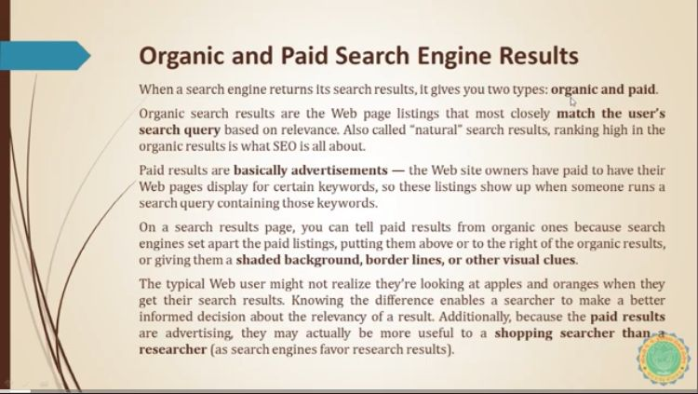

Slide 6
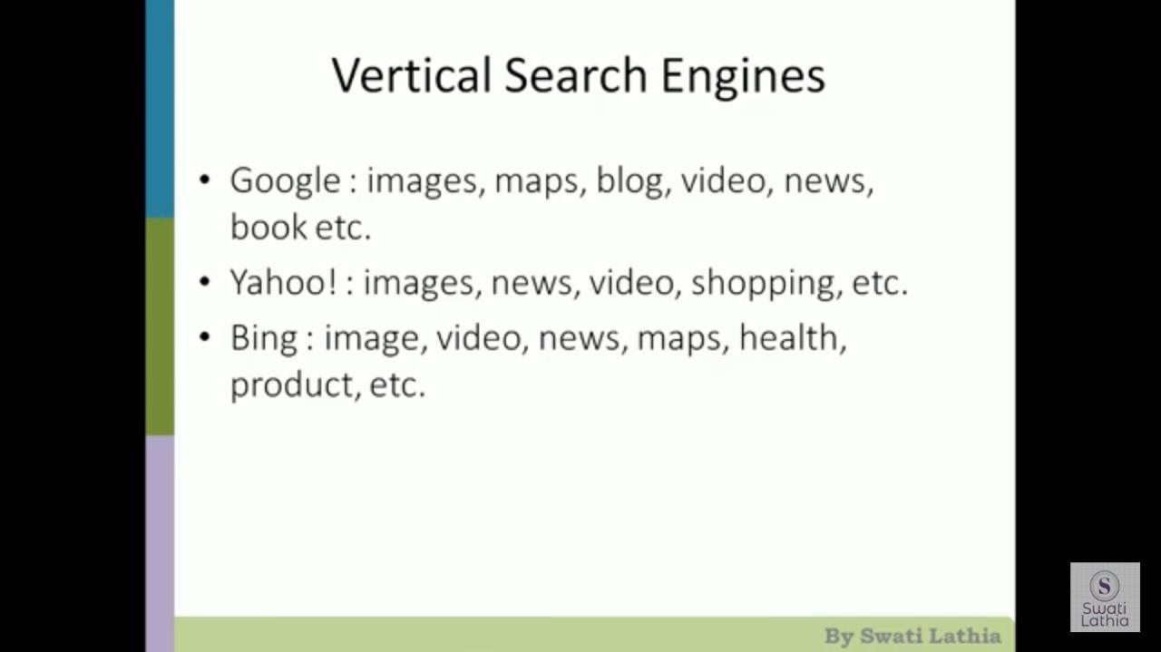

Slide 7
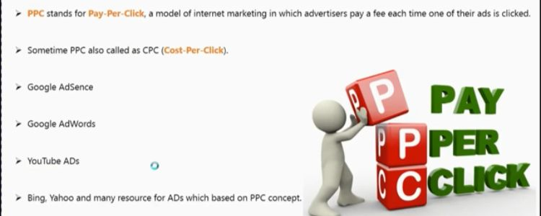

Slide 8
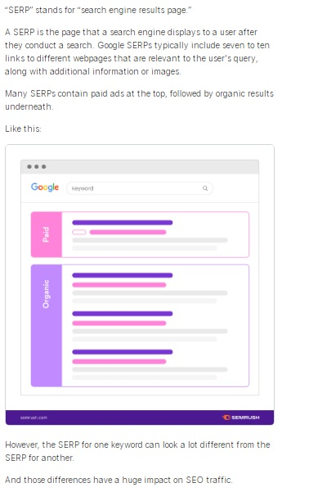

Slide 9
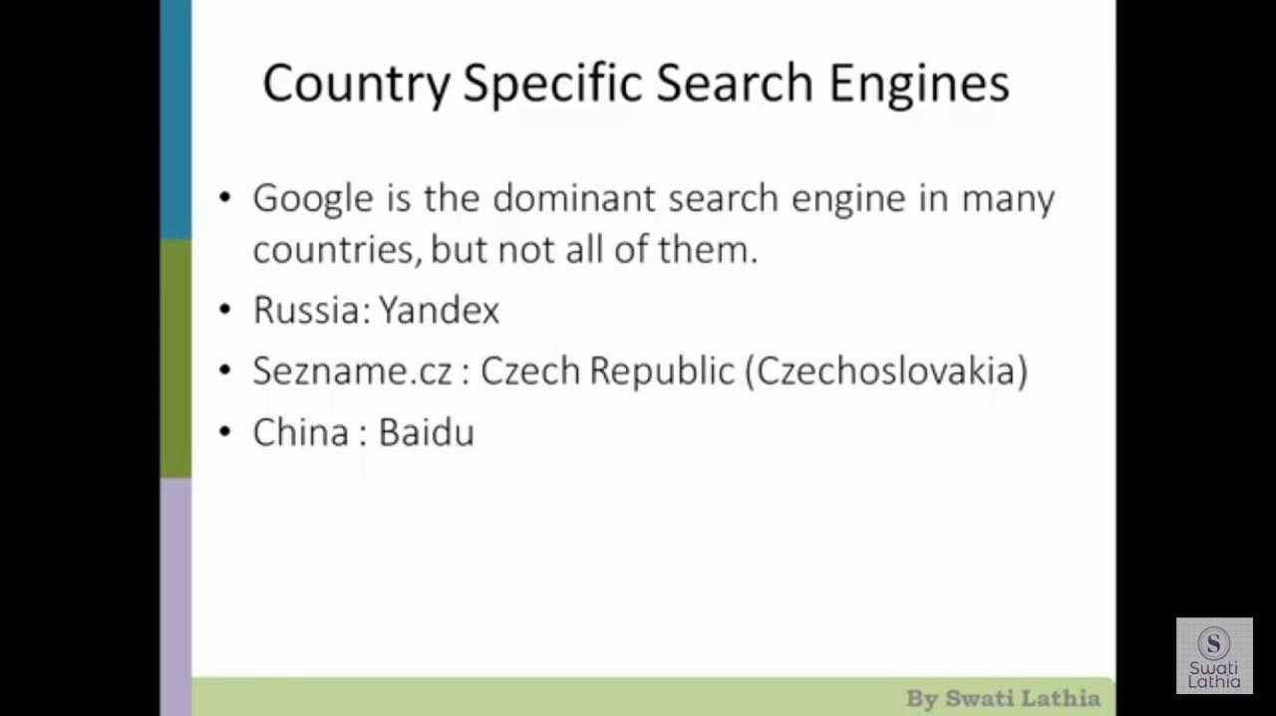

Slide 10
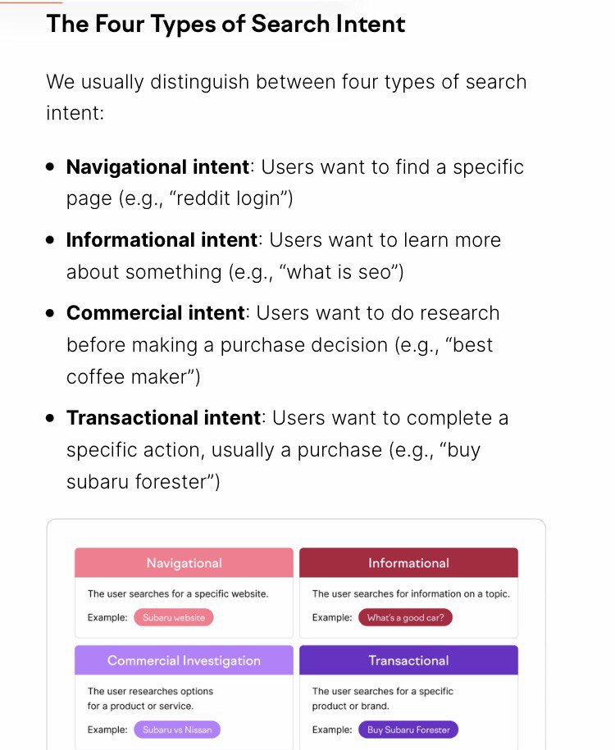

Slide 11
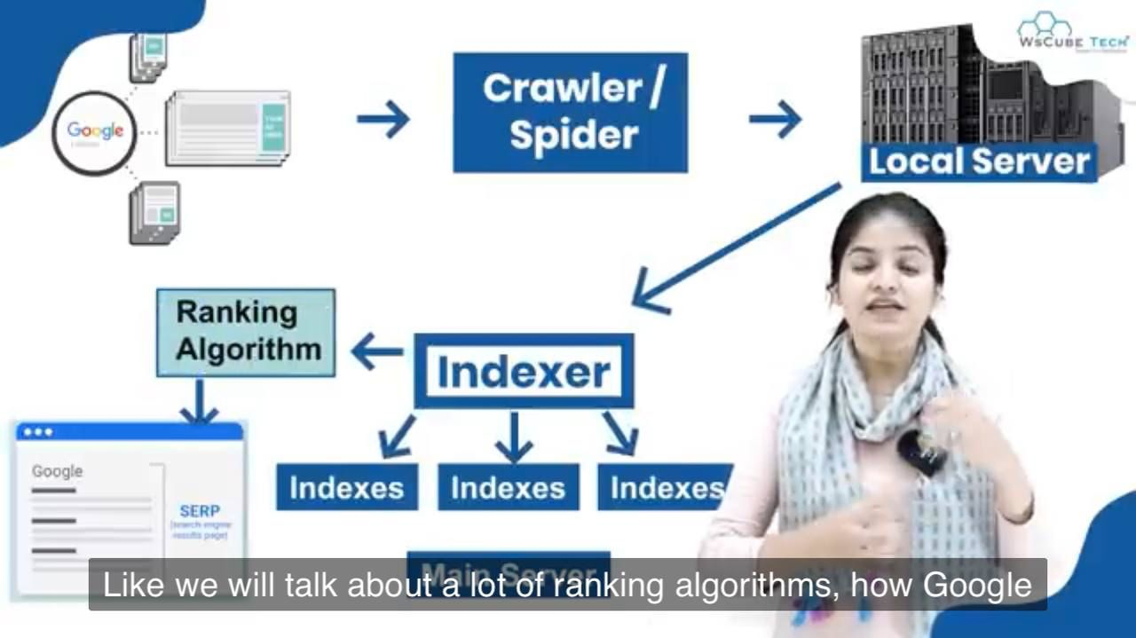

Slide 12
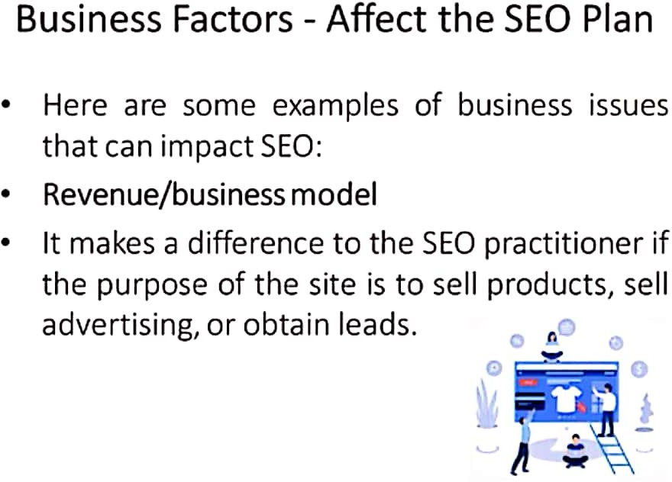

Slide 13
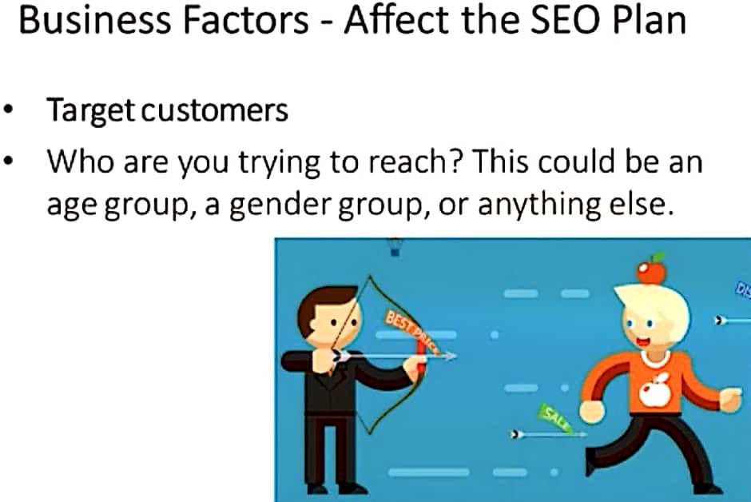

Slide 14
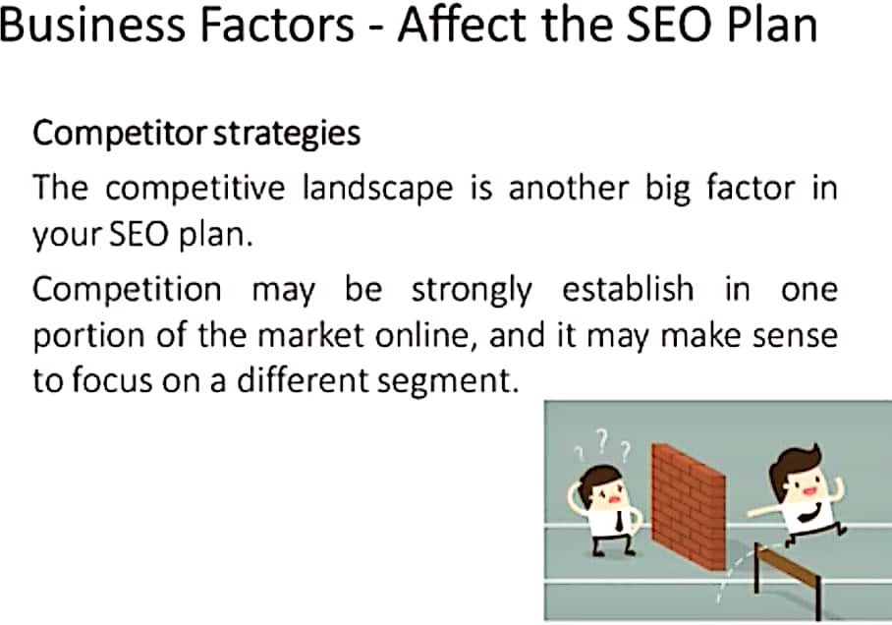

Slide 15
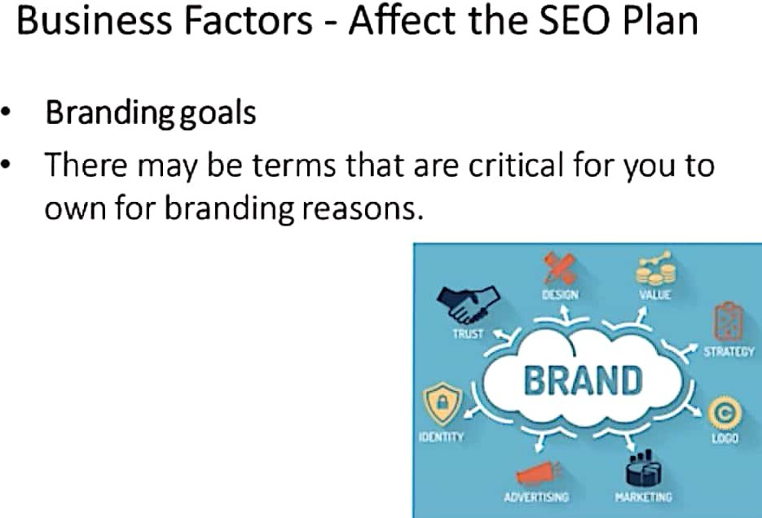

Slide 16
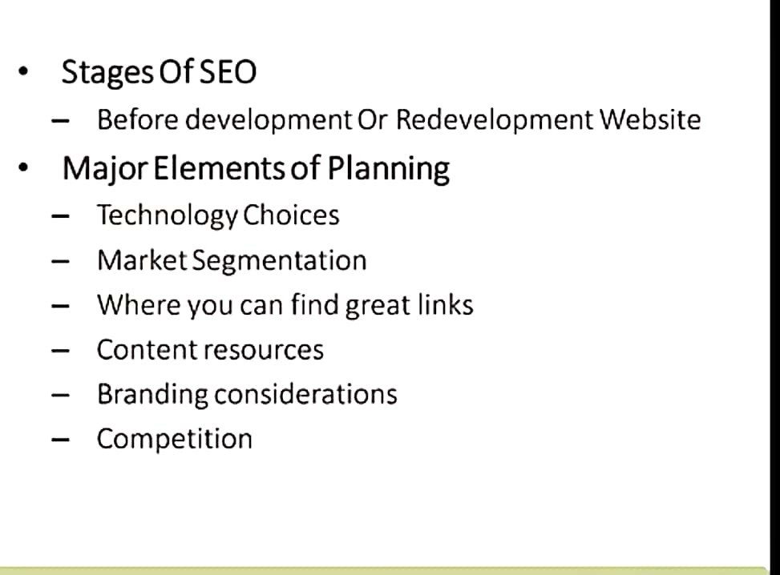

Slide 17
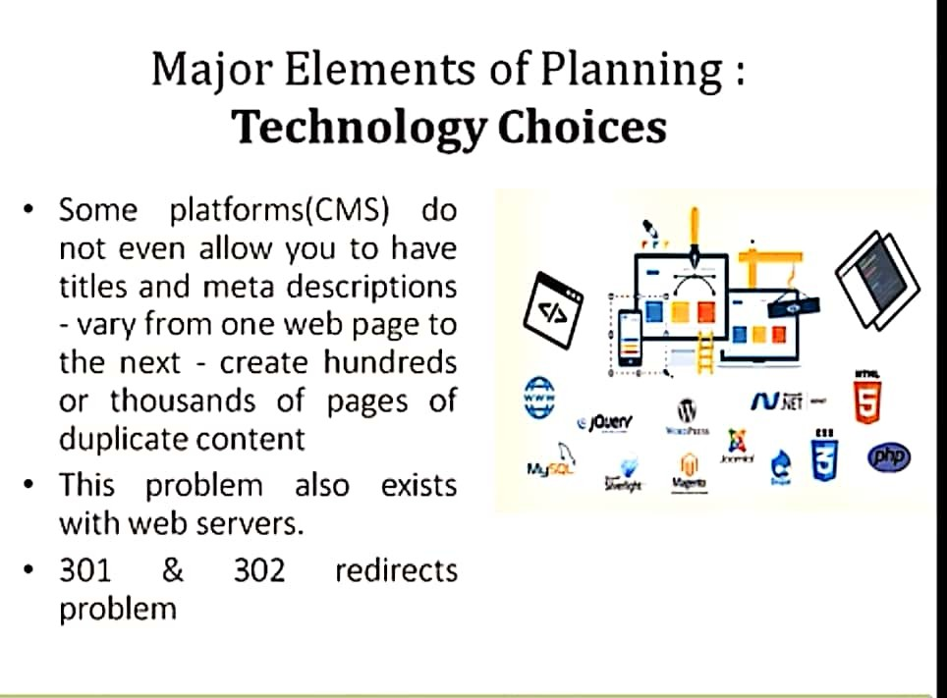

Slide 18
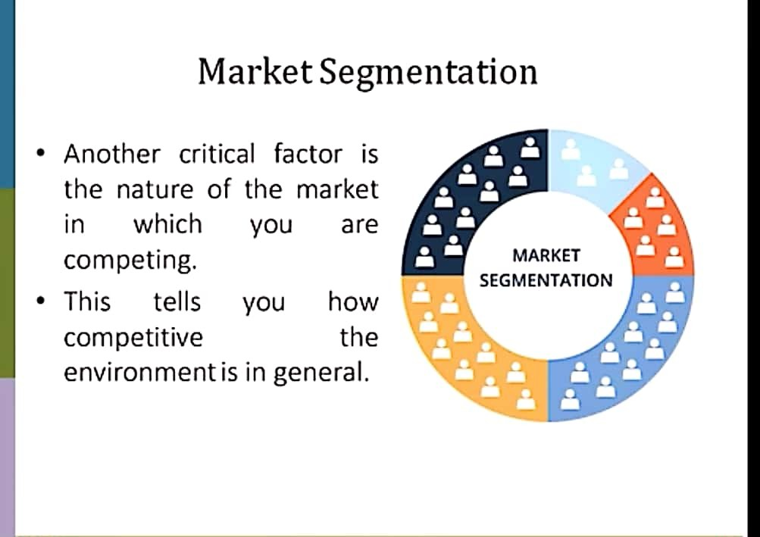

Slide 19
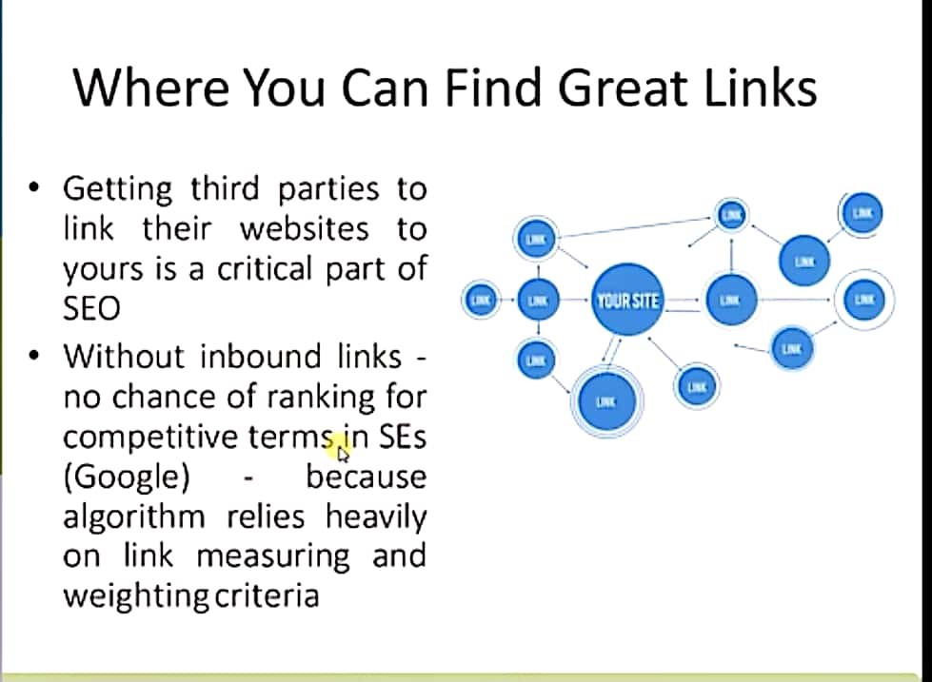

Slide 20
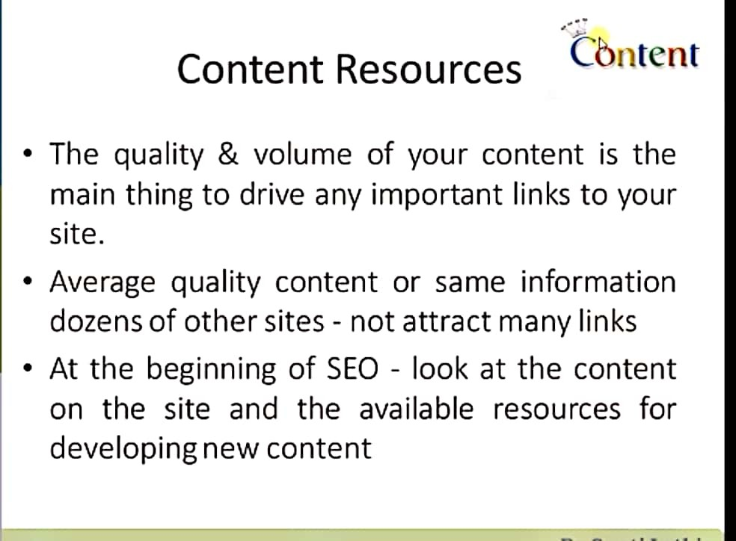

Slide 21


Slide 22
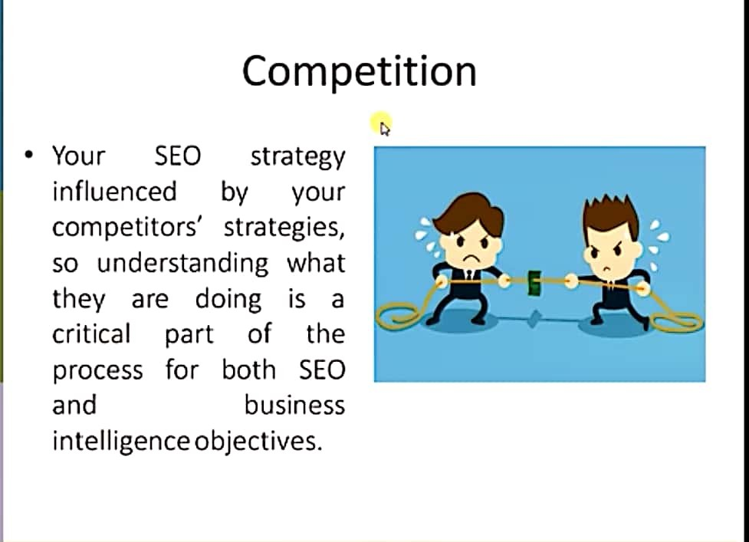

Slide 23
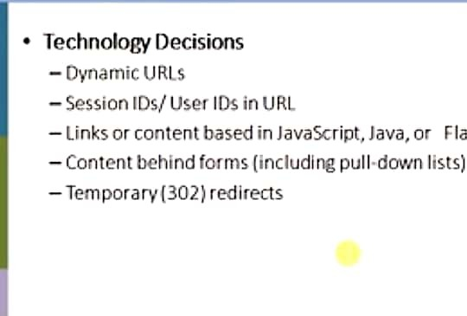

Slide 24
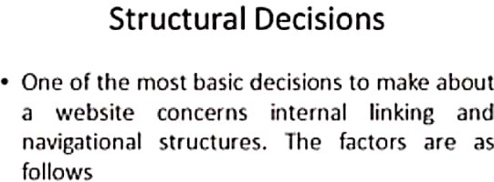

Slide 25
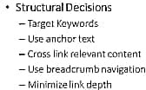

Slide 26
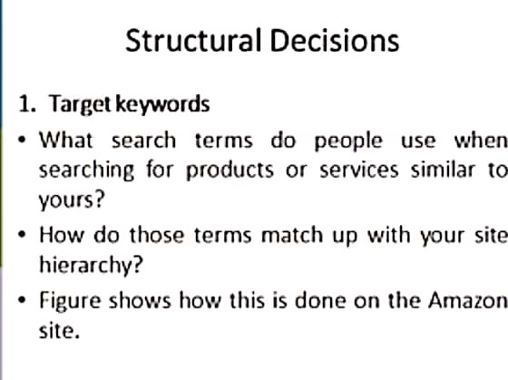

Slide 27
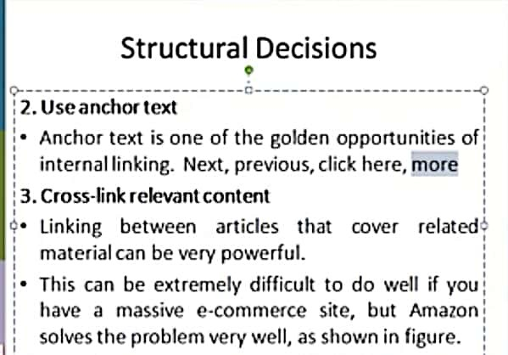

Slide 28


Slide 29
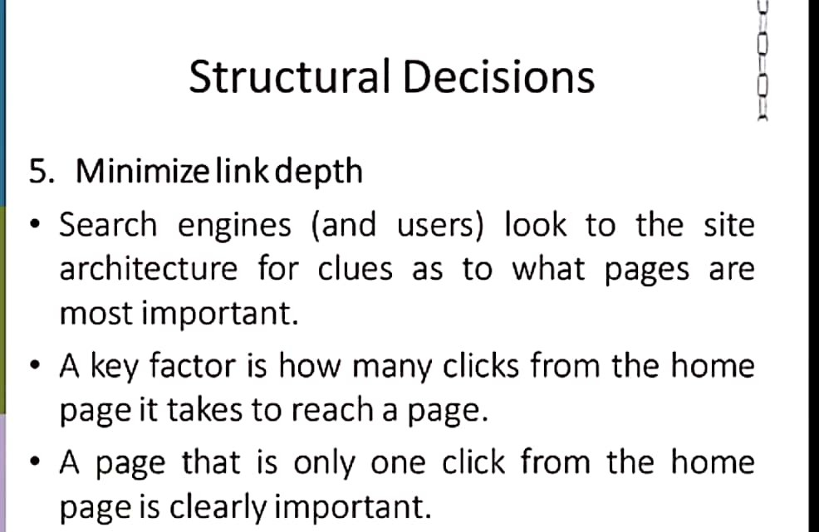

Slide 30
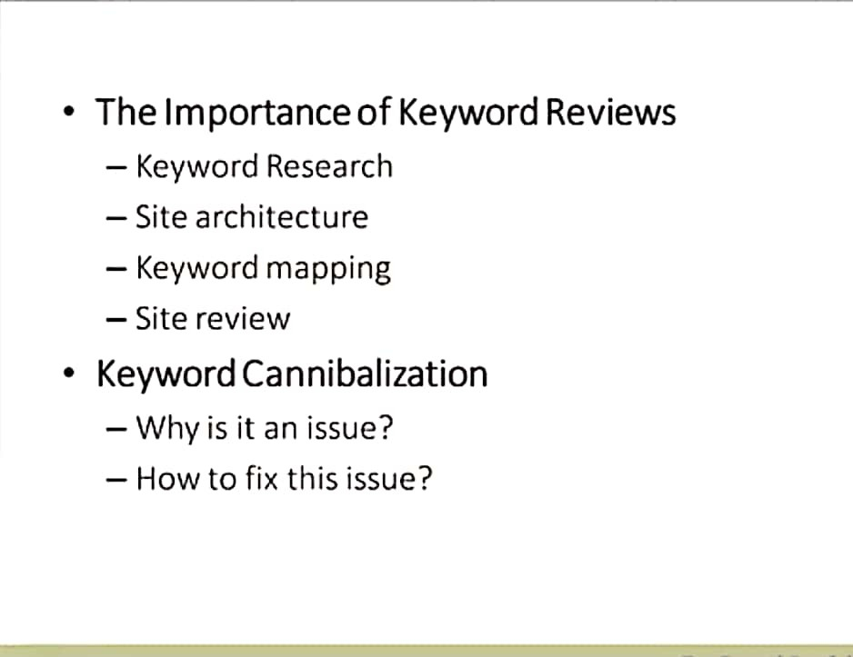

Slide 31
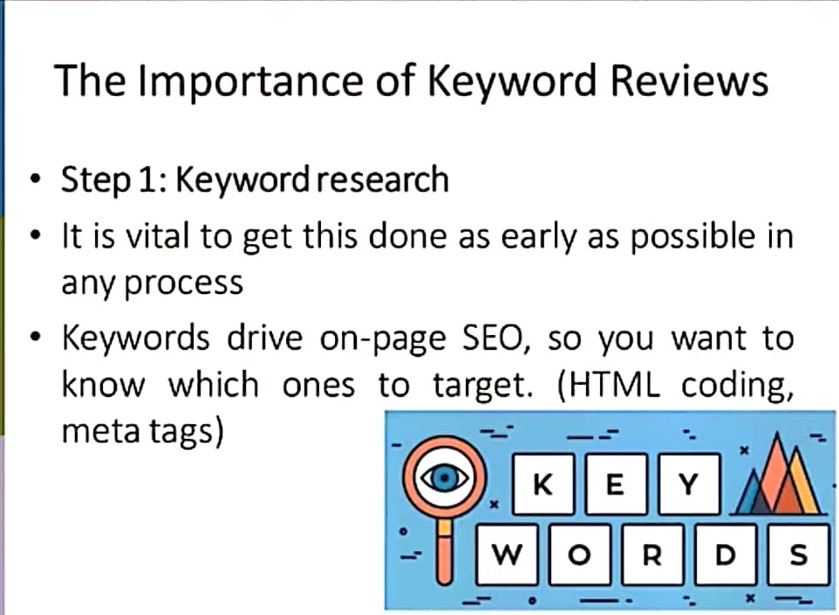

Slide 32
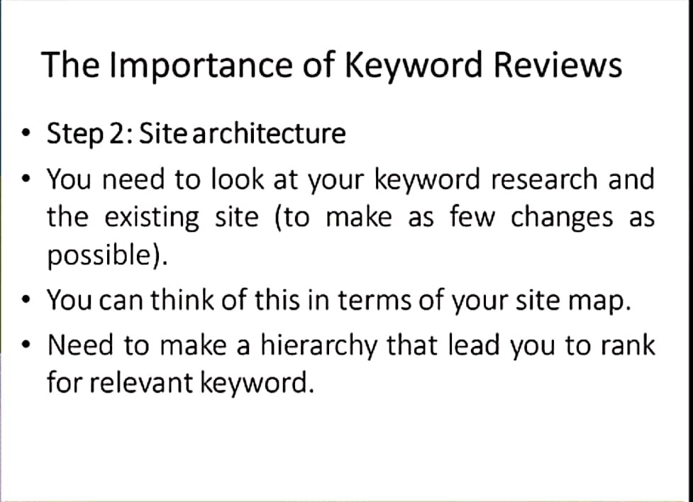

Slide 33
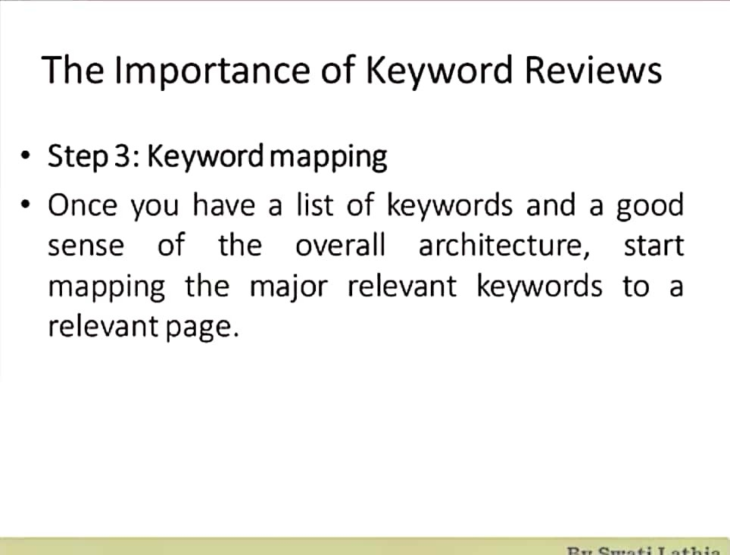

Slide 34
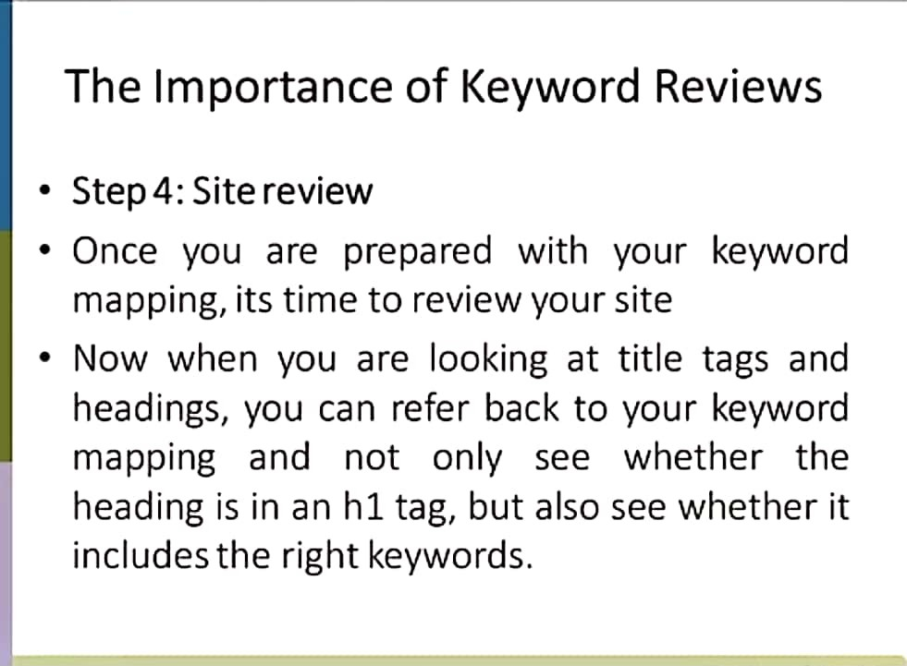

Slide 35
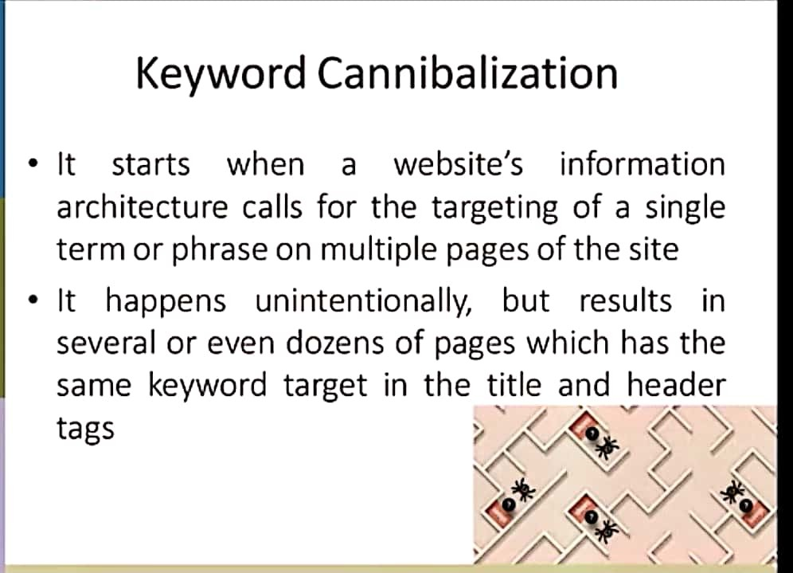

Slide 36
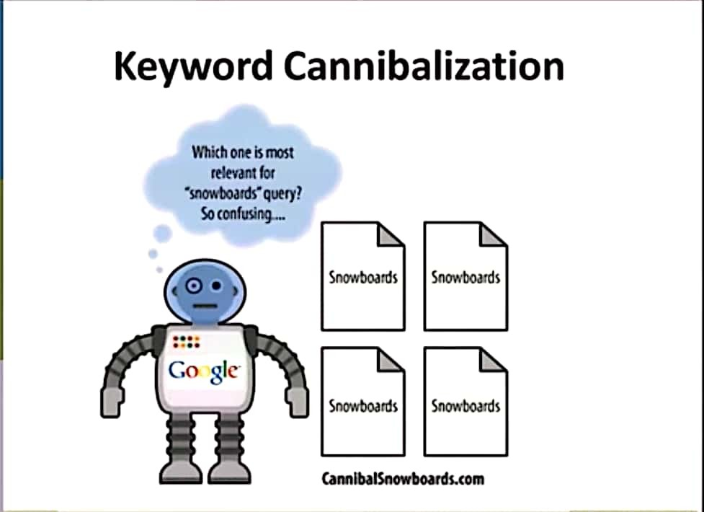

Slide 37
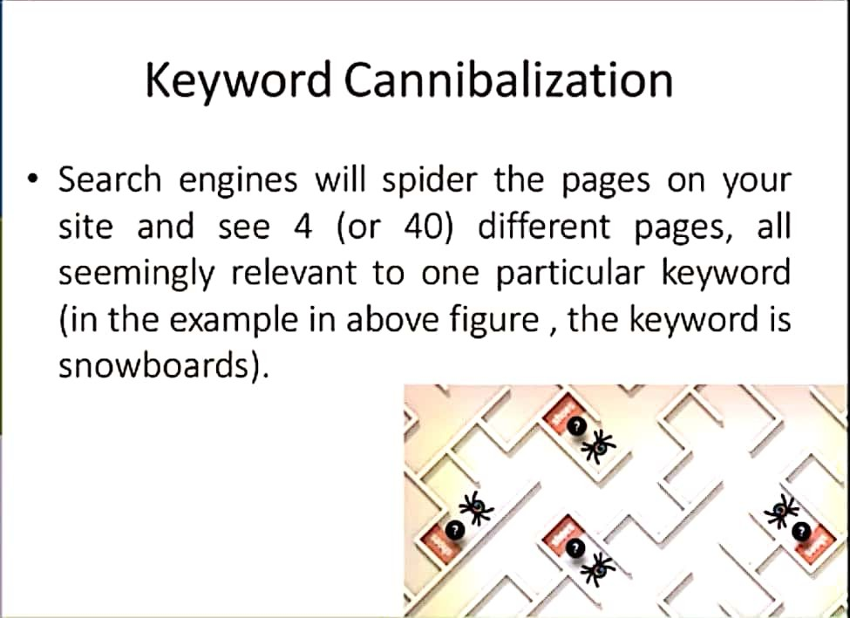

Slide 38
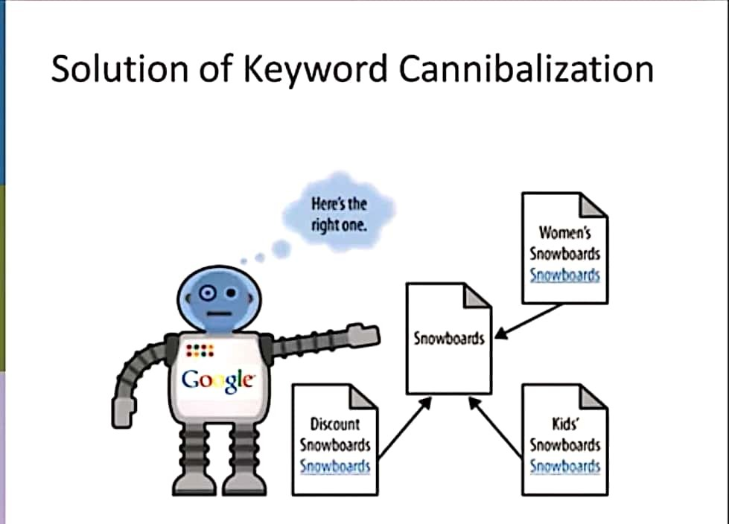

Slide 39
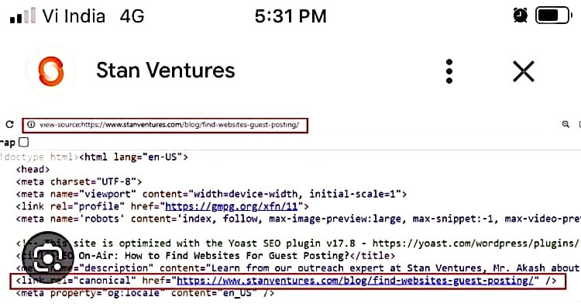

Slide 40
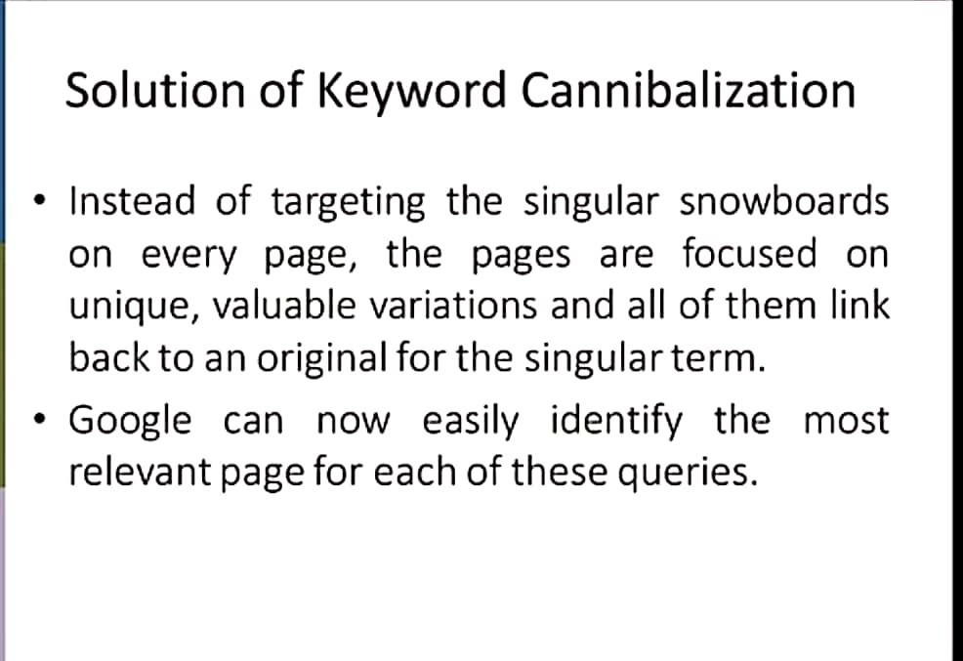

Slide 41
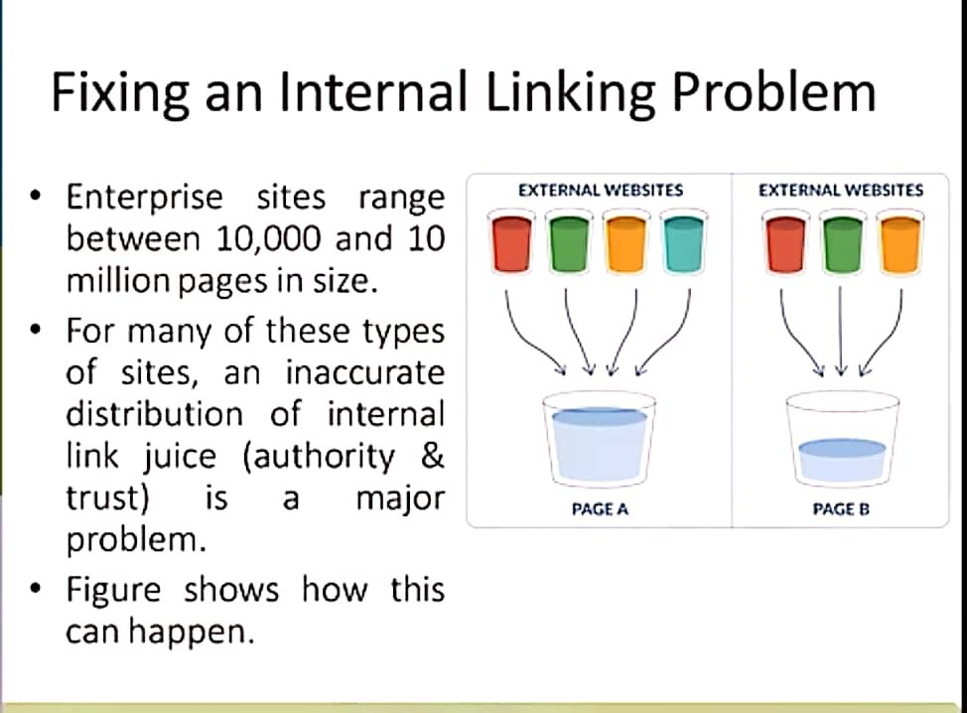

Slide 42
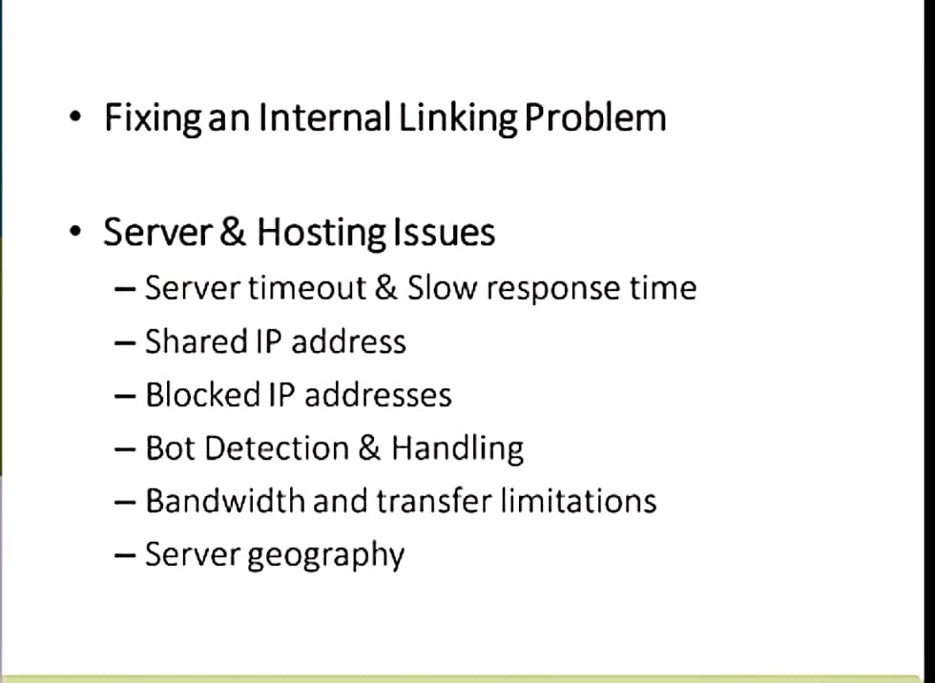

Slide 43
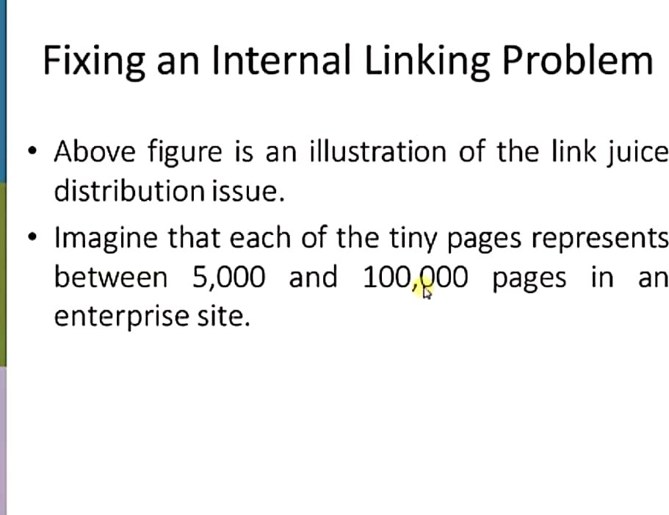

Slide 44
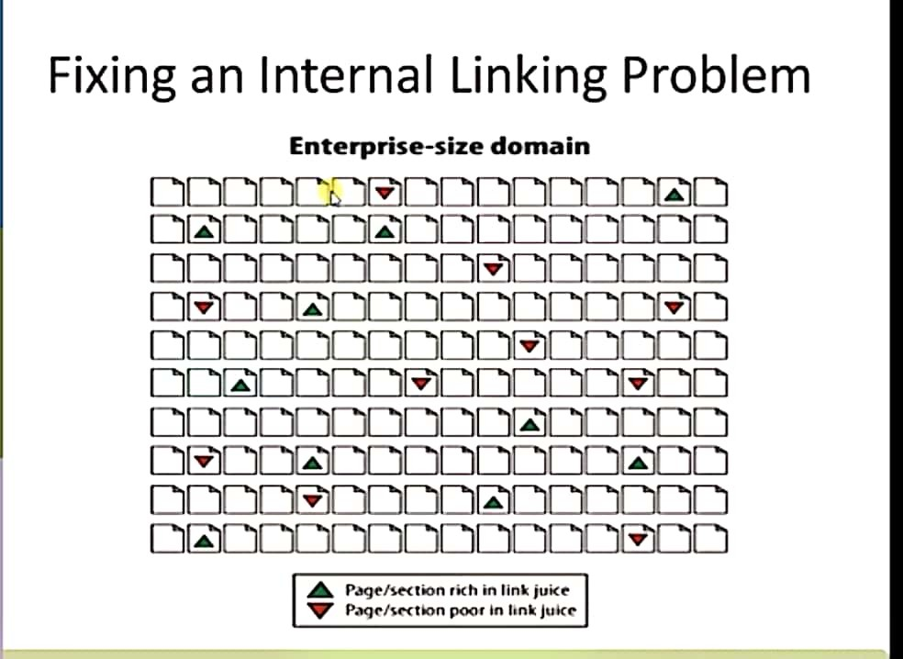

Slide 45
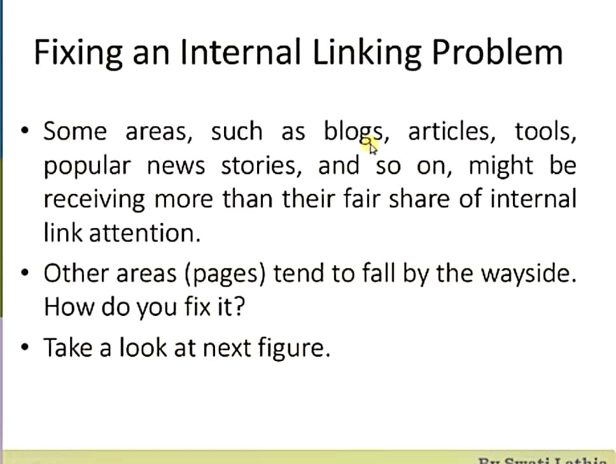

Slide 46
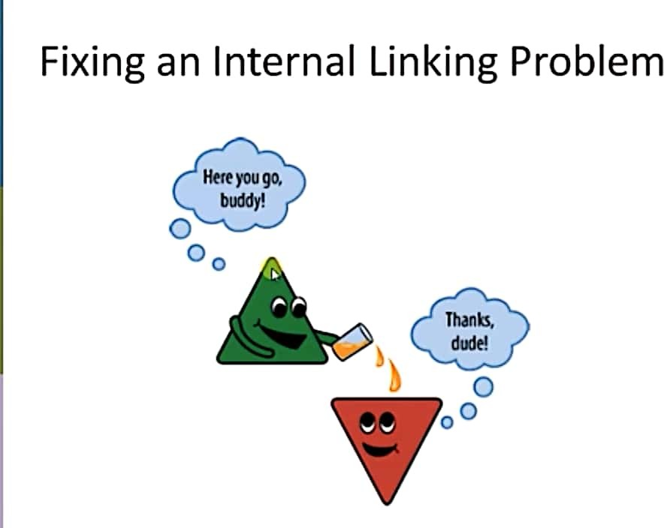

Slide 47
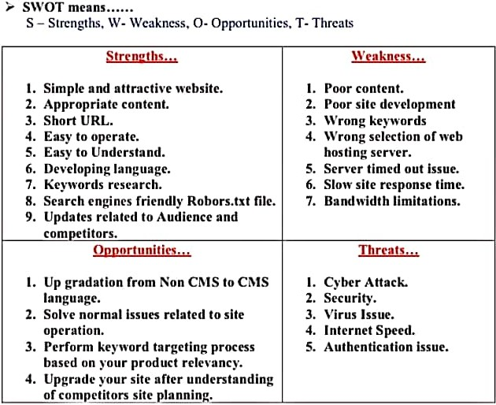

Slide 48
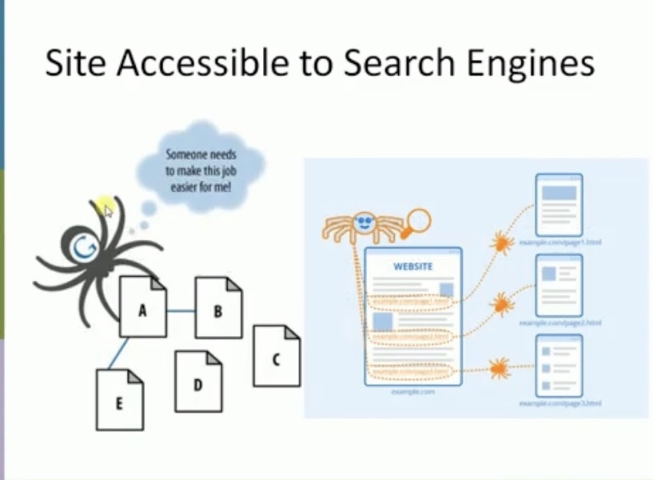

Slide 49
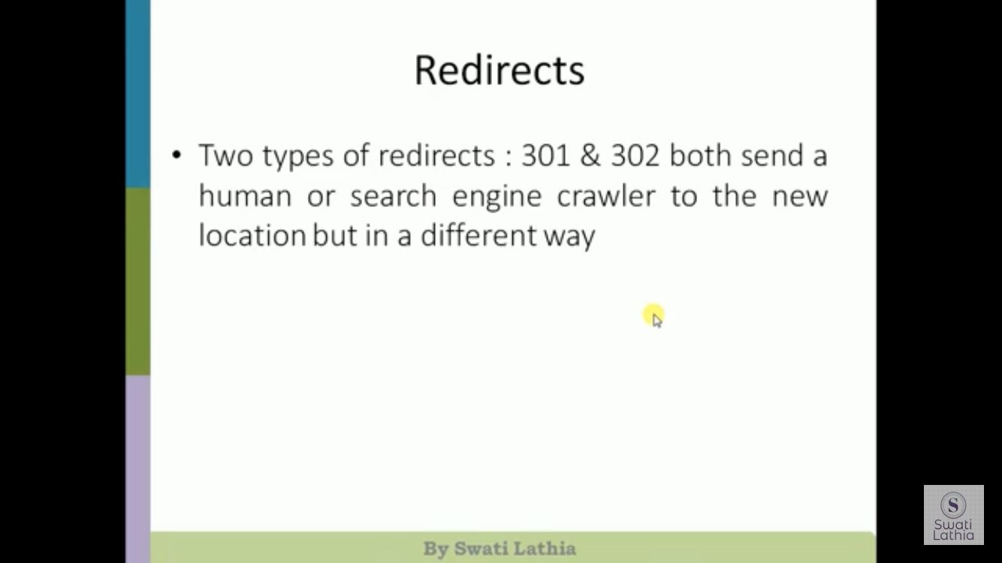

Slide 50
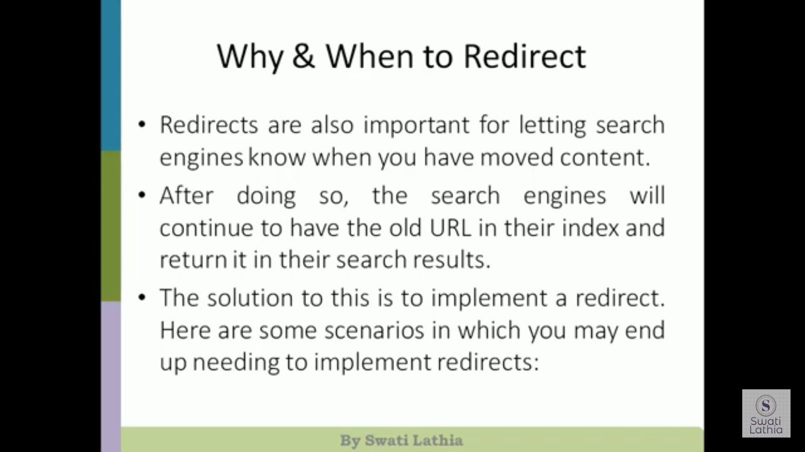

Slide 51
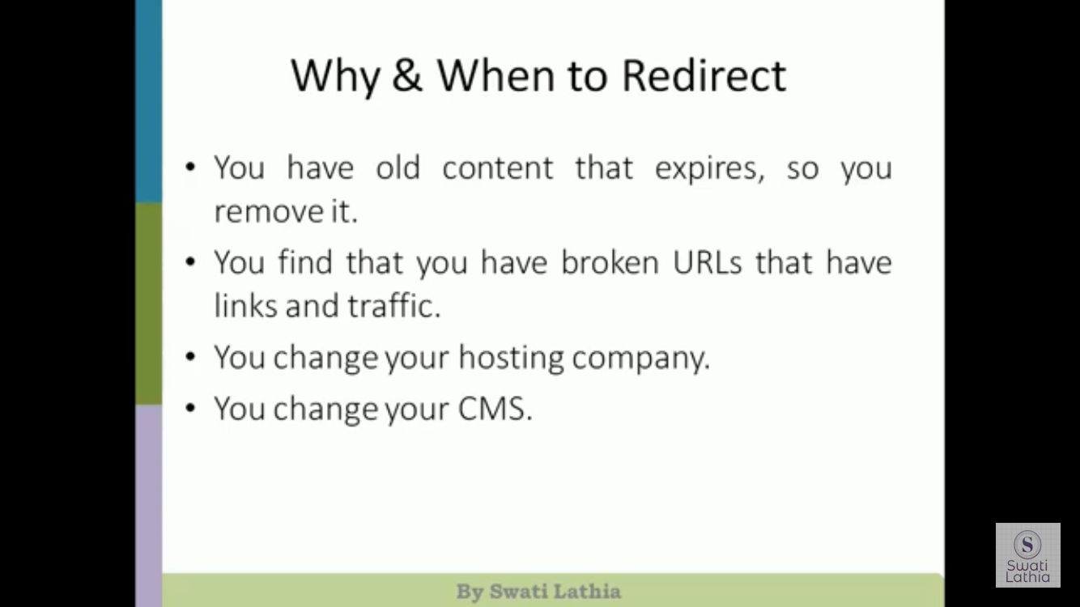

Slide 52
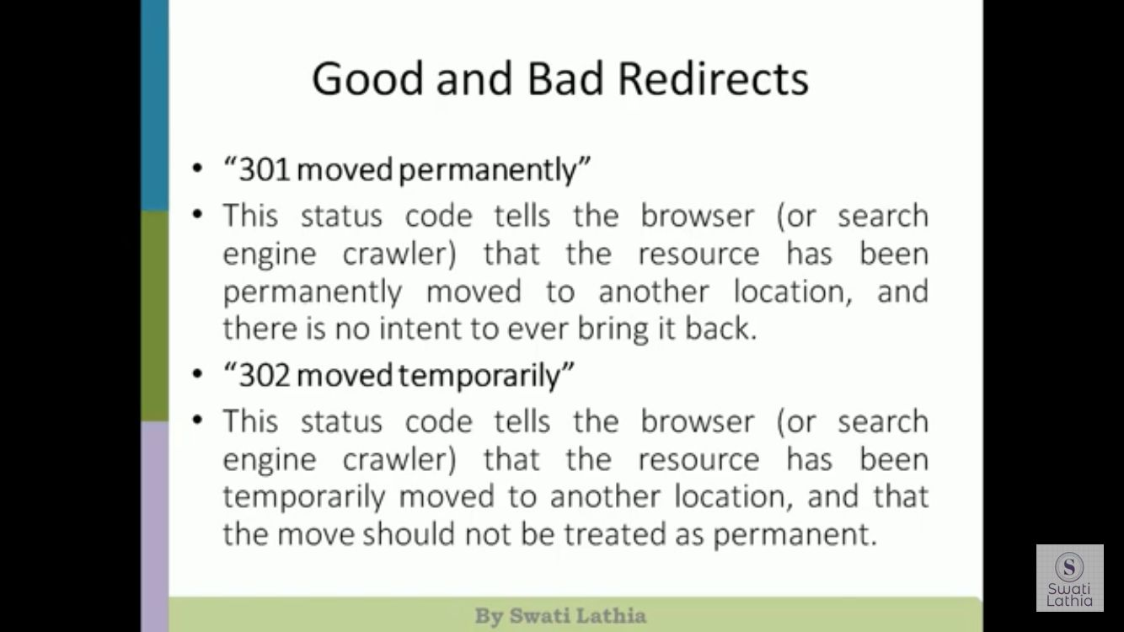

Slide 53


Slide 54


Slide 55


Slide 56


Slide 57


Slide 58


Slide 59


Slide 60


Slide 61


Slide 62


Slide 63


Slide 64


Slide 65


Slide 66


Slide 67


Slide 68


Slide 69


Slide 70


Slide 71


Slide 72


Slide 73


Slide 74


Slide 75


Slide 76


Slide 77


Slide 78


Slide 79


Slide 80


Slide 81


Slide 82


Slide 83



Slide 84


Slide 85


Slide 86


Slide 87
site:
If you want to search through specific websites like Wikipedia or YouTube,
but not other sites, site:youtube.com or site:wikipedia.org is what you need.
2. related: You can use this search operator to find websites that are related to the site in question
Related:www.amazon.com
3. OR:If you want to combine searches, simply add the capitalized OR between your search terms (keyword1 OR keyword2).
4.– Minus: Exclude keyword or phrase
Ex: seo --ppc
4.Cache :Find the most recent cache of a webpage.
Ex:cache:amazon.com

Slide 88

3 Keyword Research and Tracking Results

Slide 89


Slide 90


Slide 91


Slide 92


Slide 93


Slide 94


Slide 95


Slide 96


Slide 97


Slide 98


Slide 99

Determining Keyword Value & Leveraging the Long Tail

Slide 100


Slide 101


Slide 102


Slide 103


Slide 104


Slide 105


Slide 106
Why Measuring Success Is Essential to the SEO Process
Measuring progress of efforts is the key to be successful.
✓ Measurement of efforts during SEO project is essential to know the effectiveness of efforts,
✓ To review the work done, to produce reports and to control the project time line chart during the planning.
Following factors need to be considered while measuring the effectiveness of the site.
• Traffic rate
• Lead generation
• Revenue
• Branding value
• Acceptance

Slide 107
Measuring Search Traffic
Find and measure the keywords
2. Identify and measure inbound links.
3. Find and measure the conversion rate and traffic.
Although these tools provide valuable data, they are very limited in scope, and other tools out there provide significantly more data. ✓ Here are some of the best-known options:
•Google Analytics
• Woopra
• Clicky
• Yahoo! Web Analytics
• Web trends
Selecting the Right Analytics Package: ✓ Web analytics tools measure the site traffic in the following ways.
1. Log files tracking
2. JavaScript tracking

Slide 108
Tying SEO to Conversion and ROI
Sales/sales revenue
Email/blog/newsletter subscriptions
Sign-ups
Downloads
Contact forms and phone calls
Visitors who share
Visitors who link
Visitors who publicize

Slide 109
Competitive and Diagnostic Search Metrics
Site Indexing Data:
✓ It is valuable to know how many pages in your site are in a search engine‘s index. This is interesting for two reasons:
• To determine whether important parts of your site are not in the index (if key parts Of the site are not in the index, you can embark on an effort to determine why)
• To learn about your competitors‘ sites and strategies.
✓ One important thing to note is that the results that site: commands return are fast estimates, and aren‘t as accurate as the reports generated by Google Webmaster Tools based on your XML Sitemap. You can use them to give you a general impression, but that is all.
Link Building, Link Tracking, and Link-Based Metrics (Including Anchor Text Analysis):

Slide 110
Performance indicators for Long Tail SEO & Future Trends
Brand-to-Non-Brand Ratio
This is the percentage of your natural search traffic that comes from brand keywords versus non-brand keywords.
If the ratio is high and most of your traffic is coming from searches for your brand, this signals that your SEO is fundamentally broken. The lower the ratio, the more of the long tail of natural search you likely are capturing. This metric is an excellent gauge of the success of your optimization initiatives.
Unique Crawled URLs
This is the number of unique (nonduplicate) web pages crawled by search engine spiders such as Googlebot. Your website is like your virtual sales force, bringing in prospects from the search engines. Think of each unique page as one of your virtual salespeople. The more unique pages you have, the more opportunities you have to sell through the search engines.
Search Visitors per Contributing Page
This is the percentage of unique pages that yield search-delivered traffic in a given month.
This ratio essentially is a key driver of the length of your long tail of natural search. The more pages yielding traffic from search engines, the healthier your SEO program is. If only a small portion of your website is delivering searchers to your door, most of your pages.

